Slide 1
Exploring Data: Interning at QuantHub​
Alabama Data Scholars Internship Program
Irene Kihara​

Slide 2
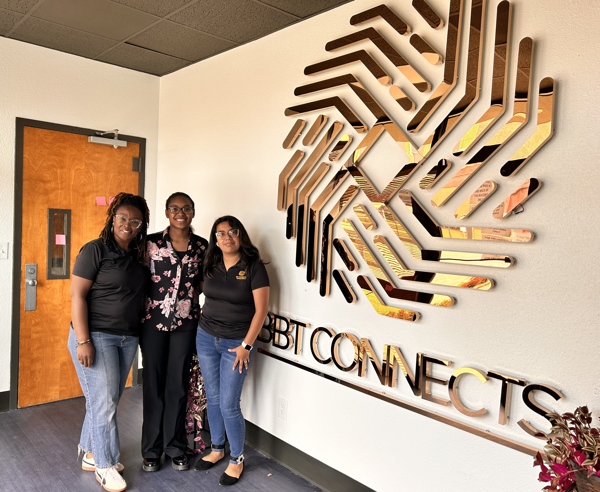
About Me
I'm a high school graduate from Spain Park High School in Hoover, Alabama
I love playing flag football, building and repairing computers, and watching my favorite TV shows like S.W.A.T.
Plan to attend The University of Alabama in Huntsville
Major: Cybersecurity Engineering
Data Scholar Intern at Blackbelt Technologies | BBT Connects in Birmingham
Mentored by Isis Ramirez

Slide 3
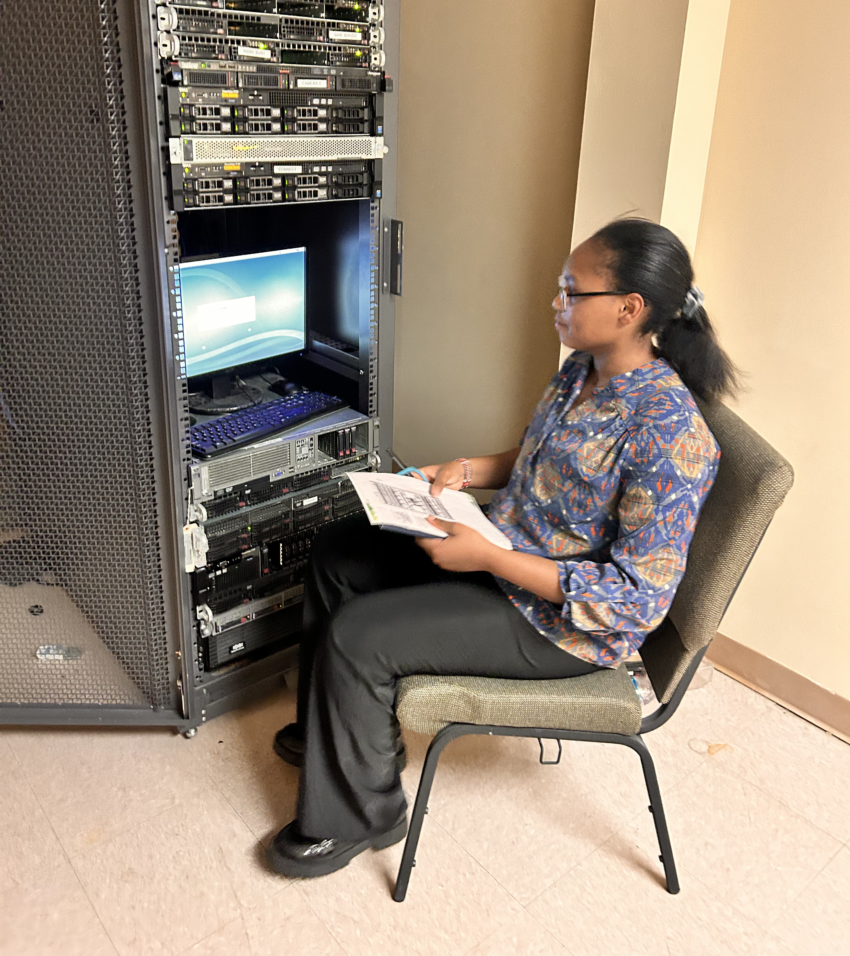
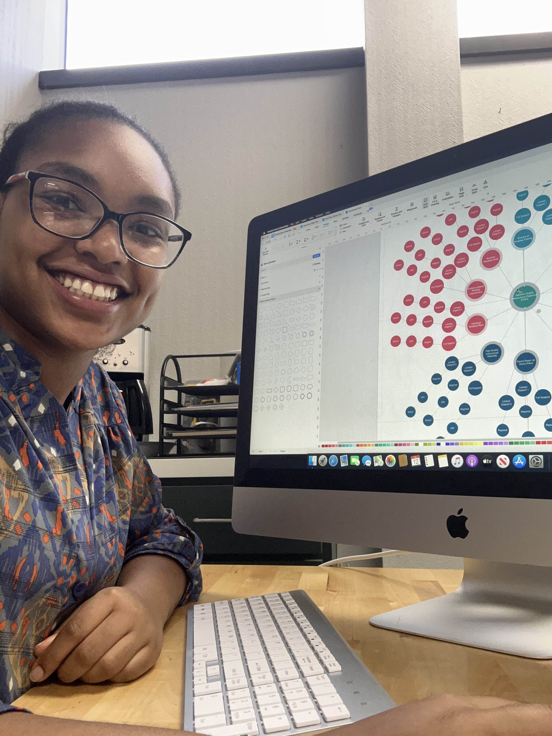
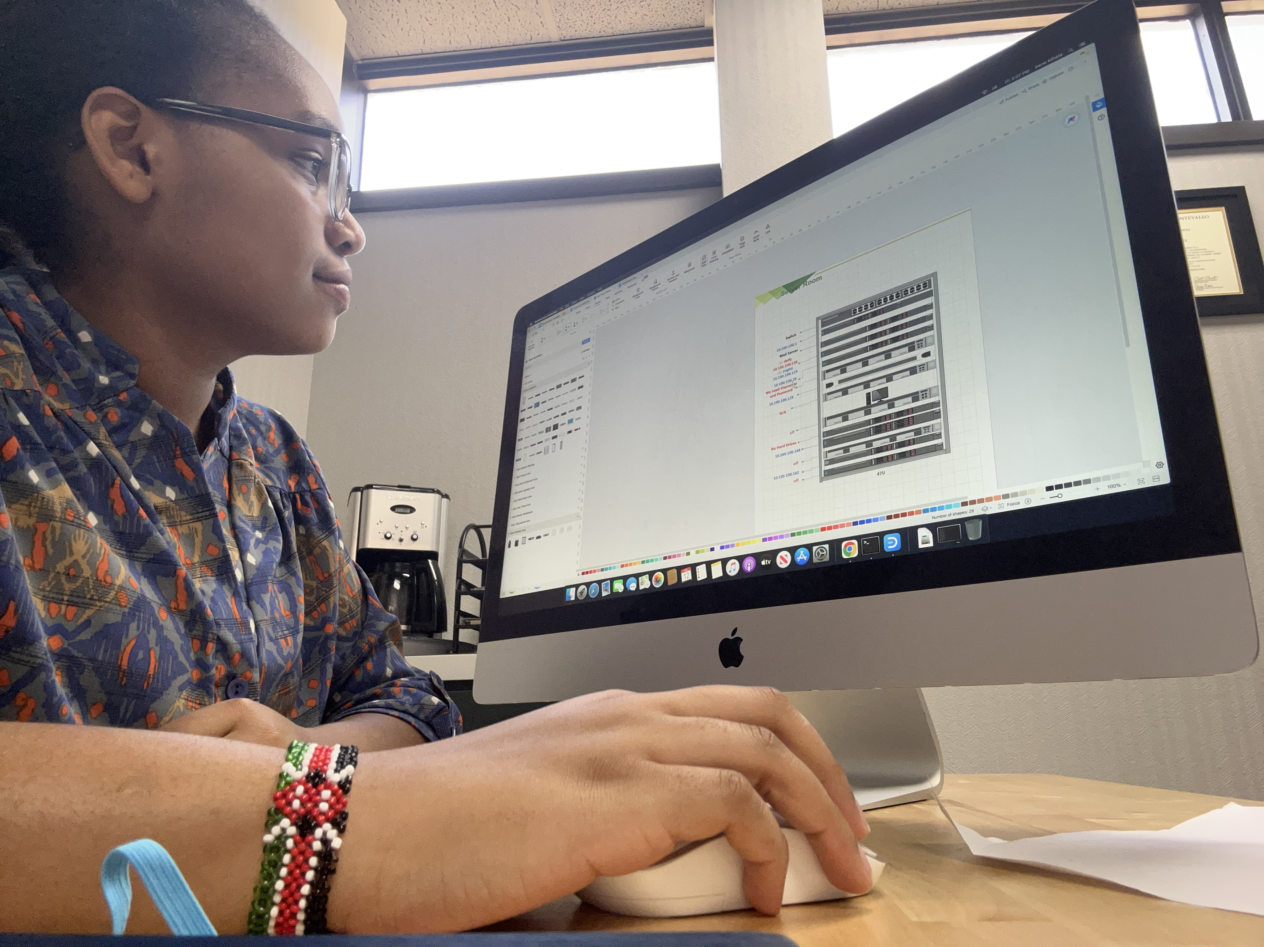
Project Overview
Assisted in designing an Quality Assurance Platform diagram for the Alabama Department of Education to visually assess district and school efficiency in preparing 3rd-grade students for higher reading levels.
Designed a visual layout of the server room with IP addresses and related information for easy identification and differentiation between servers.
Assisted off-campus at a client's building to resolve camera issues caused by excessive power demand on the MVR system. Implemented Power over Ethernet to fix the problem.

Slide 4
Lessons Learned
I really enjoyed hearing from professors about their programs and participating in workshops. The hands-on experience with Power BI, SQL, and creating a custom ChatGPT was especially valuable.
Being in the program has shown me that there's always something new to learn in the technology field, and the opportunities for continuous learning are endless.
Skills I've learned include data literacy and understanding the importance of data for organizations and government institutions to make informed decisions.
Something that surprised me is the high demand for data scientists. This showed me the crucial role data plays in helping organizations become profitable and improve their operations.

Slide 5
Thank you!

