Slide 1
My Internship at Altec
By Juan Mendoza-Marquez

Slide 2
About Me
Graduate from Midfield High School
Hobbies: Read philosophy books and playing video games
I will attend at Lawson State Community College
Major: Computer Science
I am planning to transfer to University of Alabama at Birmingham (UAB)

Slide 3
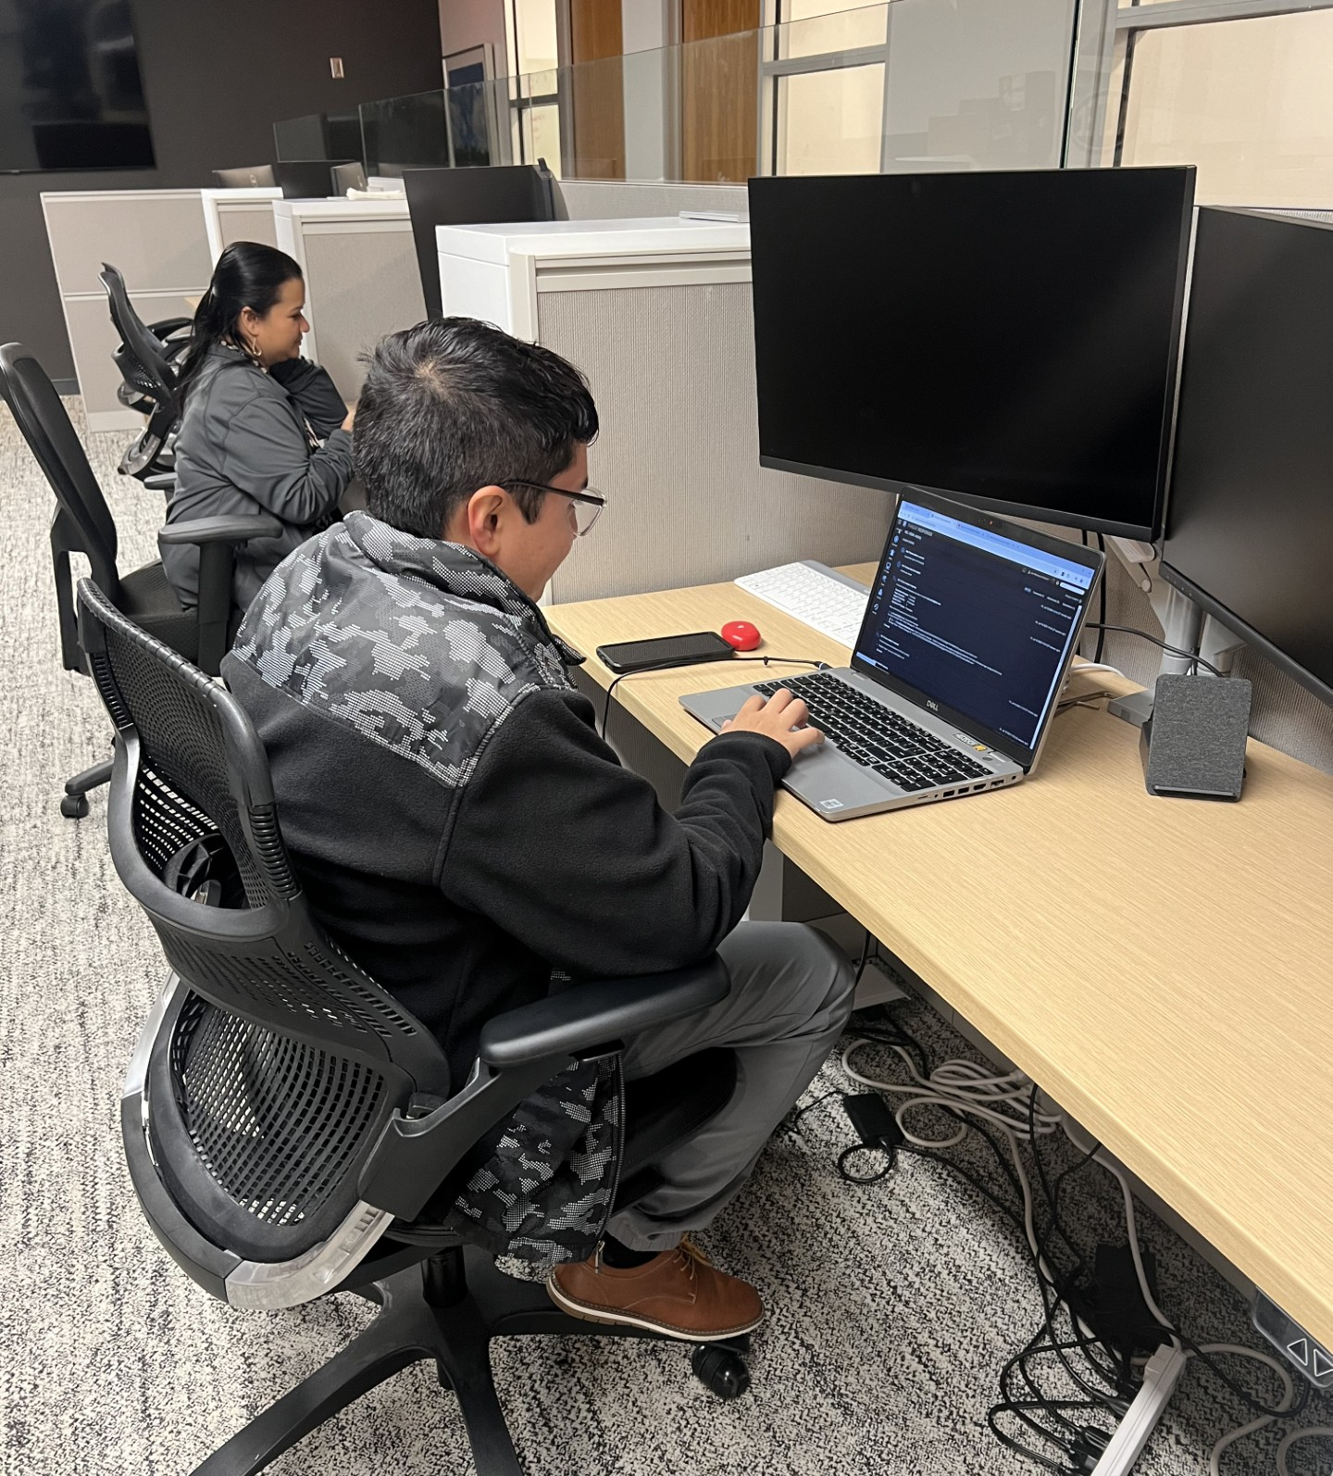
Project: Email security
I was task to identify malicious or spam email from email list
Then I sent a respond regarding the email to the associate who submitted for review
I remove the email from associate's inbox then I sent the email to quarantine folder

Slide 4
Lessons Learned
Certified Information Systems Security Professional (CISSP) by ISC2 is industry standard for Cybersecurity
Cybersecurity have lot of career path like Cloud security, Operational Technology (OT), Network Security.

Slide 5
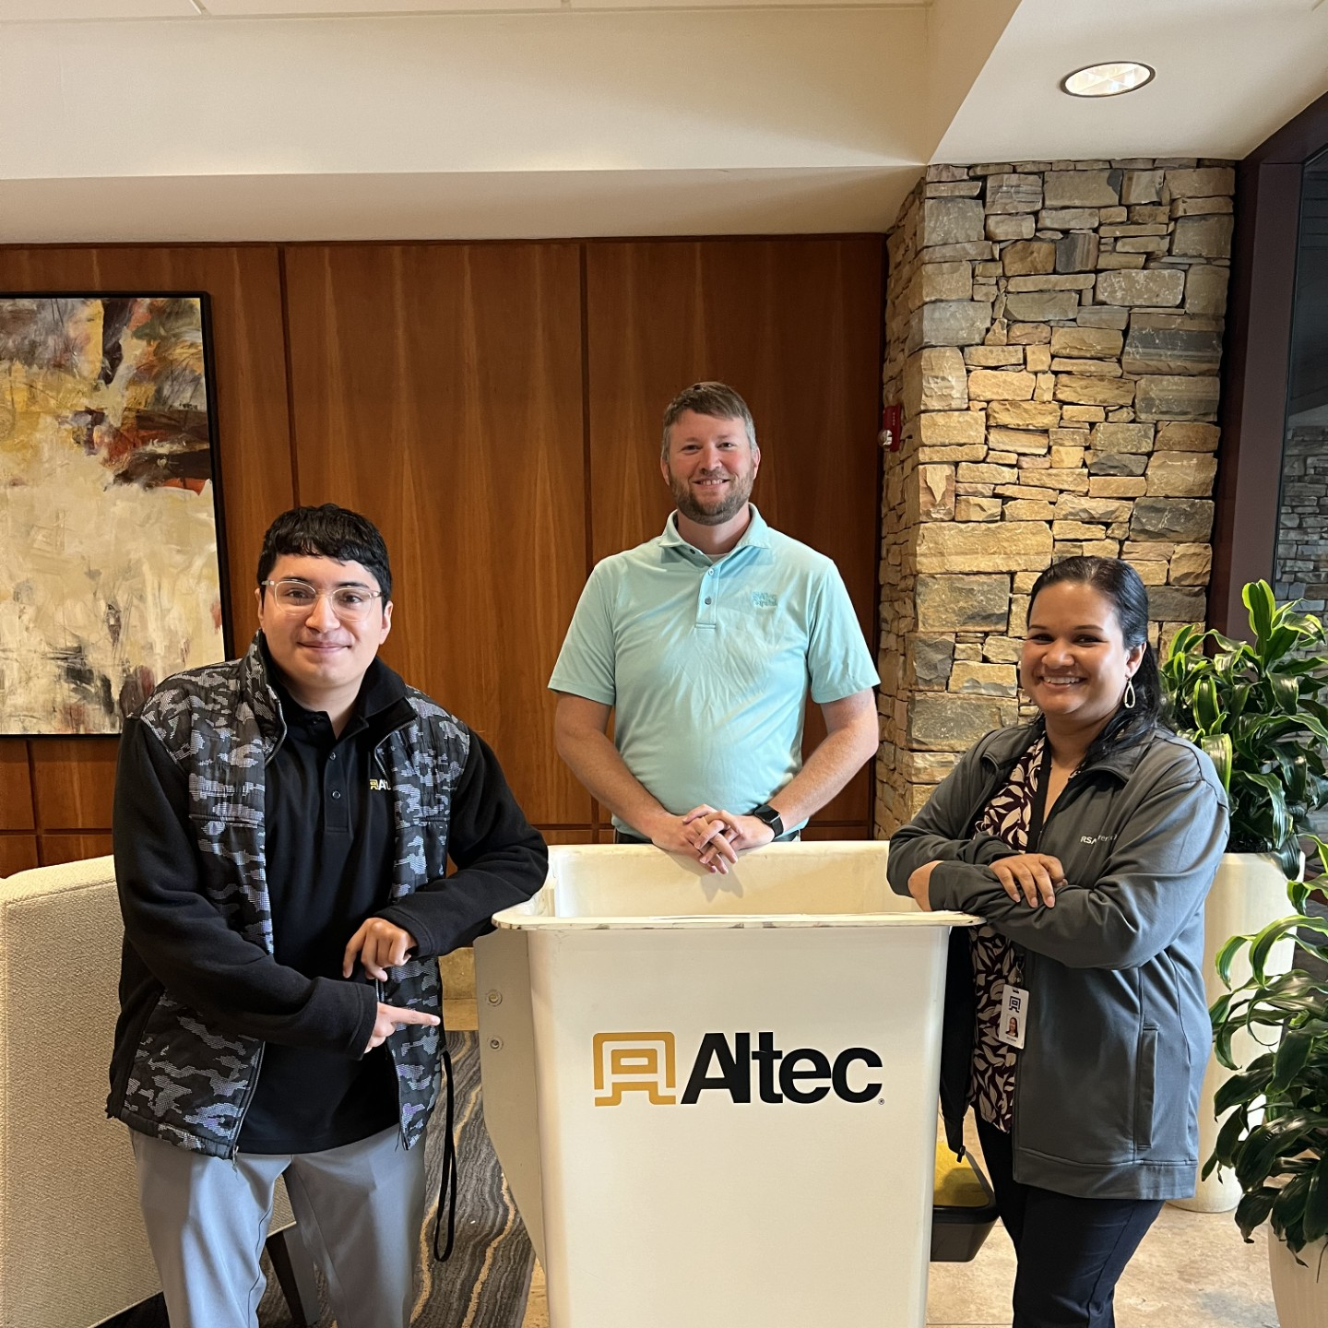
SPECIAL THANK TO ALTEC TEAM
Kiki Latimer
Jared Chandler
Nick Thomas
Jabari Armstrong
Timothy English
Carlos Esparza
Mike Charles
JoAnna Cleage

